Slide 1


Algorithms Design and Analysis
算法设计与分析
山东大学软件学院 2023

Slide 2
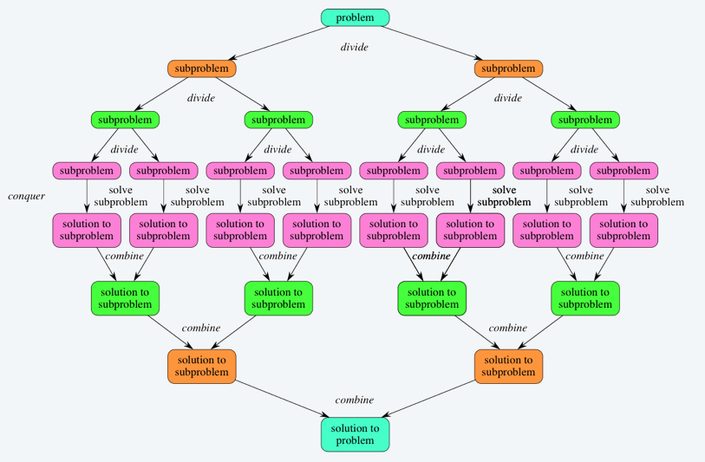
2.3 Divide-and-conquer paradigm
Divide-and-conquer
Divide up problem into several subproblems (of the same kind).
Solve (conquer) each subproblem recursively.
Combine solutions to subproblems into overall solution.

Slide 3
Divide-and-conquer paradigm
Divide-and-conquer
Divide up problem into several subproblems (of the same kind).
Solve (conquer) each subproblem recursively.
Combine solutions to subproblems into overall solution.
Most common usage
Divide problem of size n into two subproblems of size n / 2.
Solve (conquer) two subproblems recursively.
Combine two solutions into overall solution.

Slide 4
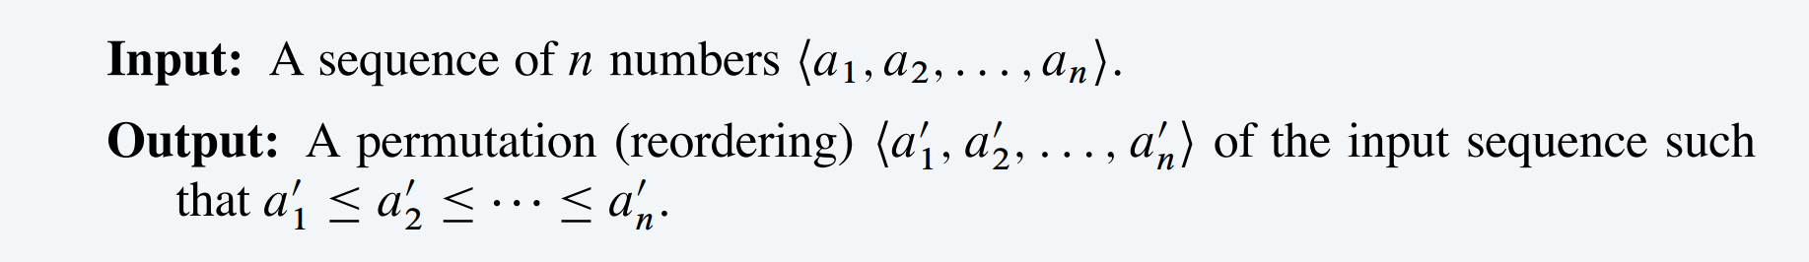
Mergesort
Sorting Problem:
For insertion sort :
we used an incremental approach: having sorted the subarray A[1..j−1], we inserted the single element A[j] into its proper place, yielding the sorted subarray A[1..j].

Slide 5
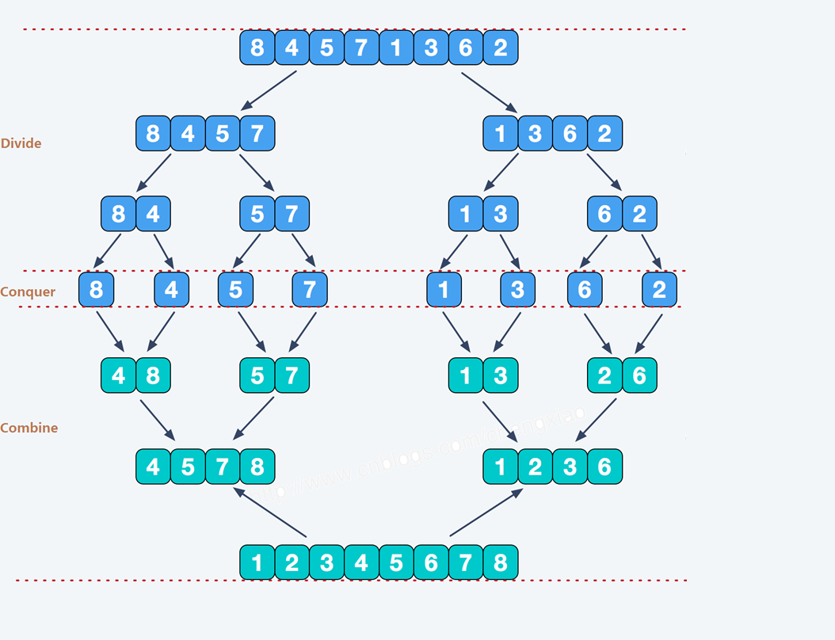
Mergesort
Divide-and-conquer.
Divide up problem into several subproblems (of the same kind).
Solve (conquer) each subproblem recursively.
Combine solutions to subproblems into overall solution.

Slide 6
Mergesort algorithm
Sorting Problem:
MERGE-SORT(L)
IF (list L has one element) RETURN L.
Divide the list into two halves A and B.
A ← MERGE-SORT(A). B ← MERGE-SORT(B). L ← MERGE(A, B).
RETURN L.

Slide 7
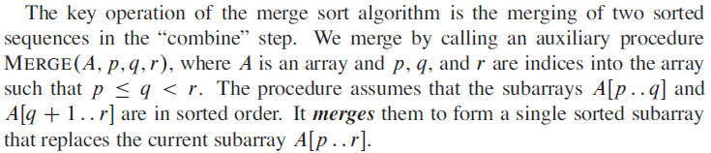
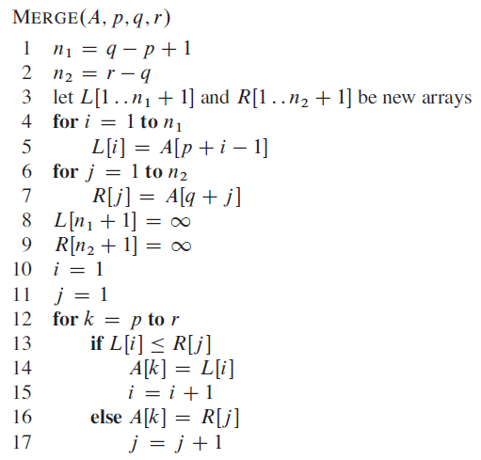
Merge(A, p, q, r)

Slide 8
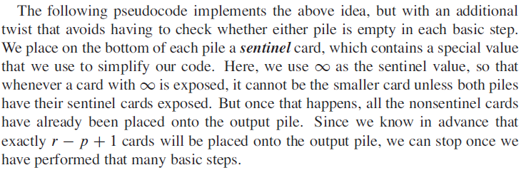
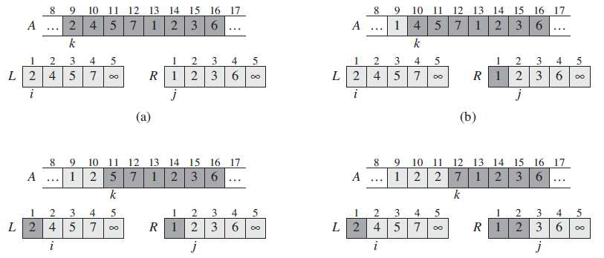
Merge(A, p, q, r)

Slide 9
Analysis of Mergesort algorithm
MERGE-SORT(L)
IF (list L has one element) RETURN L.
Divide the list into two halves A and B.
Θ(1)
A ← MERGE-SORT(A). B ← MERGE-SORT(B). L ← MERGE(A, B).
RETURN L.
T (n / 2)
T (n / 2)
Θ(n)
Def.
T (n) = max number of compares to mergesort a list of length n.

Slide 10
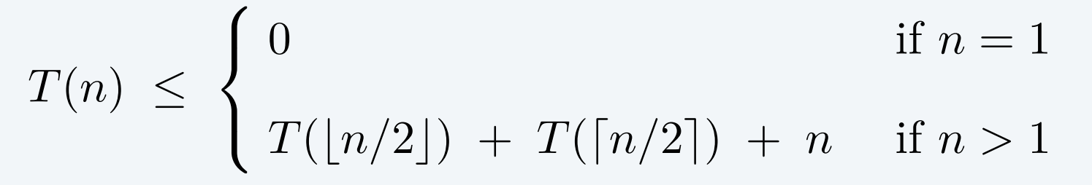
A useful recurrence relation
Recurrence relation.
c
cn
Solution.
T (n) is O(n log₂ n).
Proofs. We describe two ways to solve this recurrence.

Slide 11
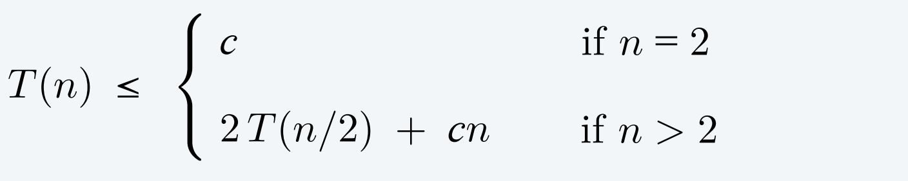

Proof by induction (restricted case: n is a power of 2)
Proposition. If T (n) satisfies the following recurrence, then T (n) ≤ cn log₂ n.
c
2
cn
For convenience, n starts from 2
2
Assume n is a power of 2
Pf. [ by induction on n ]
Base case: when n = 2, T(2) ≤ c ≤ cn log₂ n.
Inductive hypothesis: assume T(n) ≤ cn log₂ n.
Goal: show that T(2n) ≤ 2cn log₂ (2n).
T(2n)
≤ 2 T(n) + 2cn
≤ 2 cn log2 n + 2cn
= 2 cn (log2 (2n) – 1) + 2cn
= 2 cn log2 (2n). ▪
inductive hypothesis

Slide 12

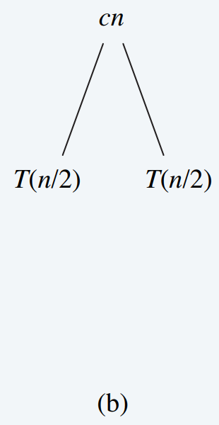
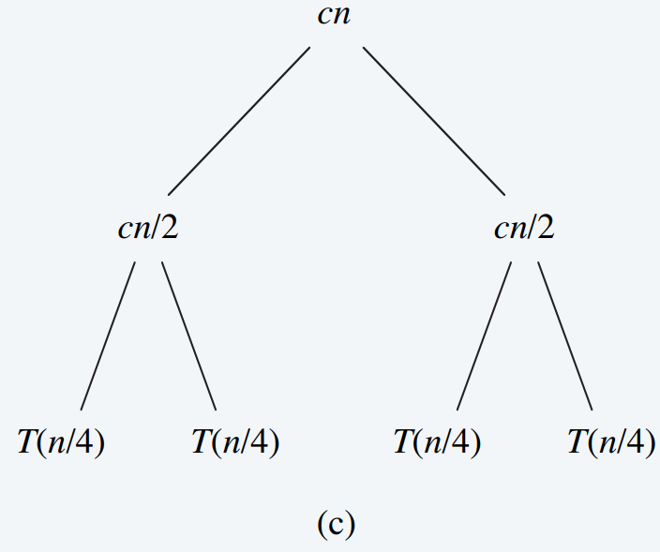
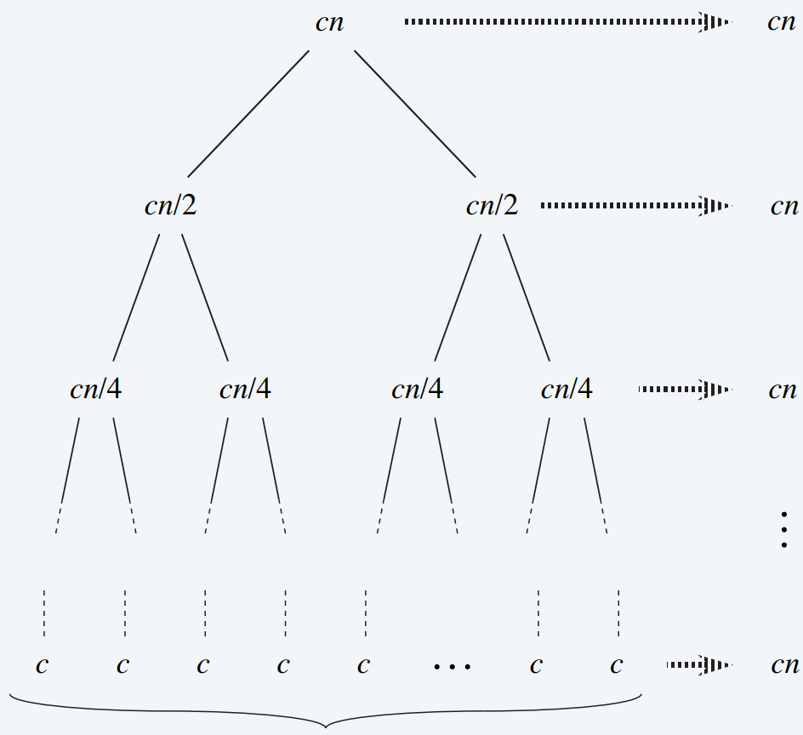


Divide-and-conquer recurrence: recursion tree
(a)
(b)
(d)
(c)
log₂n + 1

Slide 13
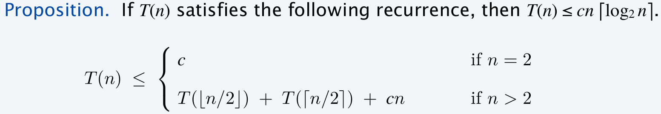
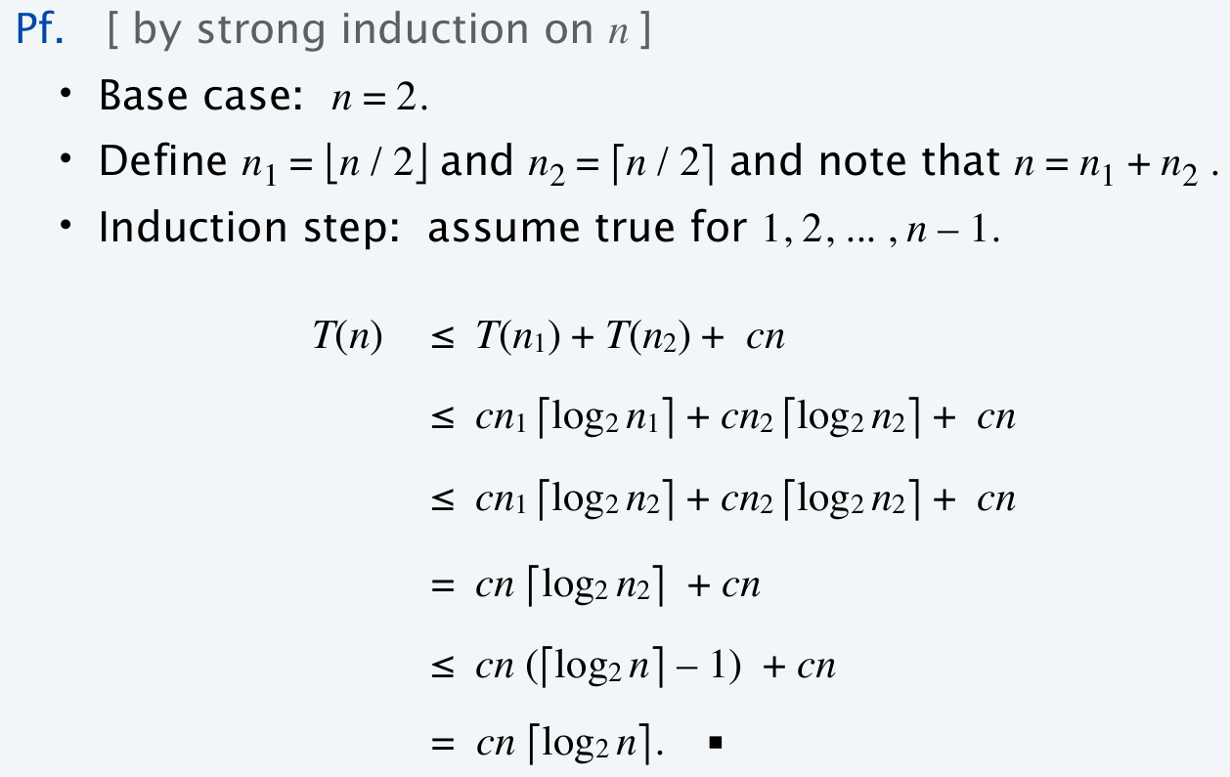
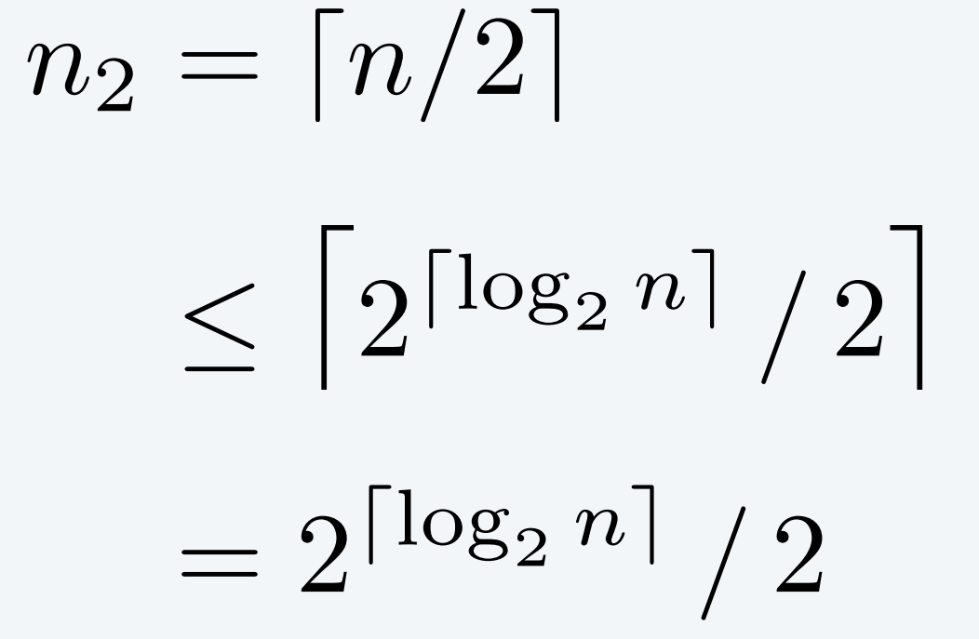
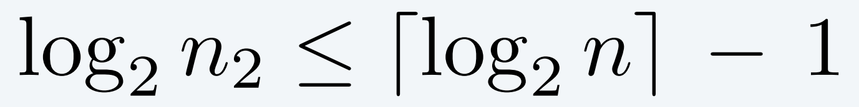
Proof by induction (general case)
no longer assuming n
is a power of 2
inductive hypothesis

